Slide 1
Specifications, Modeling, and Model of Computation
Jian-Jia Chen
(slides are based on Peter Marwedel)
TU Dortmund,
Informatik 12
© Springer, 2010
2014年 10 月 08日
These slides use Microsoft clip arts. Microsoft copyright restrictions apply.

Slide 2
Hypothetical design flow
Design repository
2: Specification
Design
3: ES-hardware
8. Test *
Application Knowledge
6: Application mapping
5: Evaluation & Validation (energy, cost, performance, …)
7: Optimization
4: System software (RTOS, middleware, …)
* Could be integrated into loop
Numbers denote sequence of chapters

Slide 3
Motivation for considering specs & models
  Why considering specs and models in detail?
  If something is wrong with the specs,
  then it will be difficult to get the design right, potentially wasting a lot of time.
  Typically, we work with models of the system under design (SUD)
  What is a model anyway?
time

Slide 4
Models
Definition: A model is a simplification of another entity, which can be a physical thing or another model. The model contains exactly those characteristics and properties of the modeled entity that are relevant for a given task. A model
is minimal with respect to a task if it does not contain any other characteristics than those relevant for the task.
[Jantsch, 2004]:
Which requirements do we have for our models?

Slide 5
Requirements for specification & modeling techniques: Hierarchy
Hierarchy
Humans not capable to understand systems
containing more than ~5 objects.
Most actual systems require more objects
☞ Hierarchy (+ abstraction)
  Behavioral hierarchy
  Examples: states, processes, procedures.
  Structural hierarchy
  Examples: processors, racks,
  printed circuit boards
proc
proc
proc

Slide 6
Requirem. for specification & modeling techniques (2): Component-based design
  Systems must be designed from components
  Must be “easy” to derive behavior from
  behavior of subsystems
  Work of Sifakis, Thiele, Ernst, …
  Concurrency
  Synchronization and communication

Slide 7

Requirements for specification & modeling techniques (3): Timing
  Timing behavior
  Essential for embedded and cy-phy systems!
    Additional information (periods, dependences, scenarios, use cases) welcome
    Also, the speed of the underlying platform must be known
    Far-reaching consequences for design processes!
“The lack of timing in the core abstraction (of computer science) is a flaw, from the perspective of embedded software” [Lee, 2005]

Slide 8
Requirements for specification & modeling techniques (3): Timing (2)
4 types of timing specs required, according to Burns, 1990:
Measure elapsed time
Check, how much time has elapsed since last call
?
execute
t
Means for delaying processes
t

Slide 9
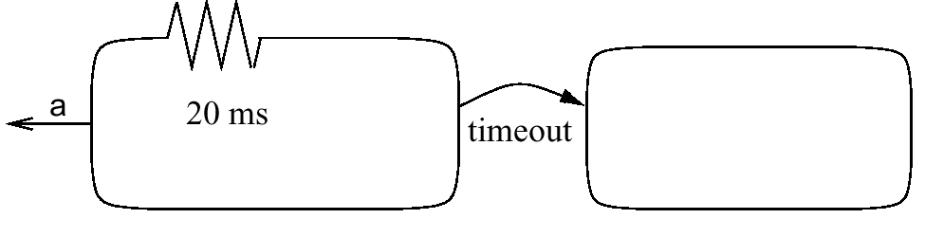

Requirements for specification & modeling techniques (3): Timing (3)
Possibility to specify timeouts
Stay in a certain state a maximum time.
Methods for specifying deadlines
Not available or in separate control file.
execute
t

Slide 10
Specification of ES (4): Support for designing reactive systems
  State-oriented behavior
  Required for reactive systems;
  classical automata insufficient.
  Event-handling
  (external or internal events)
  Exception-oriented behavior
  Not acceptable to describe exceptions for every state
We will see, how all the arrows labeled k can be replaced by a single one.

Slide 11

Requirements for specification & modeling techniques (5): More Features
  Presence of programming elements
  Executability (no algebraic specification)
  Support for the design of large systems ( OO)
  Domain-specific support
  Readability
  Portability and flexibility
  Termination
  Support for non-standard I/O devices
  Non-functional properties
  Support for the design of dependable systems
  No obstacles for efficient implementation
  Adequate model of computation
  What does it mean “to compute”?

Slide 12
Problems with classical CS theory and von Neumann (thread) computing
Even the core … notion of “computable” is at
odds with the requirements of embedded software.
In this notion, useful computation terminates, but termination is undecidable.
In embedded software, termination is failure, and yet to get predictable timing, subcomputations must decidably terminate.
What is needed is nearly a reinvention of computer science.
Edward A. Lee: Absolutely Positively on Time, IEEE Computer, July, 2005
  Search for non-thread-based, non-von-Neumann MoCs.

Slide 13
Models of computation
What does it mean, “to compute”?
Models of computation define:
  Components and an execution model for computations for each component
  Communication model for exchange of information between components.
C-1
C-2

Slide 14
Dependence graph: Definition
Sequence constraint
Nodes could be programs or simple operations
Def.: A dependence graph is a directed graph G=(V,E) in which E ⊆ V × V is a relation.
If (v₁, v₂) ∈ E, then v₁ is called an immediate predecessor of v₂ and v₂ is called an immediate successor of v₁.
Suppose E* is the transitive closure of E.
If (v₁, v₂) ∈ E*, then v₁ is called a predecessor of v₂ and v₂ is called a successor of v₁.

Slide 15
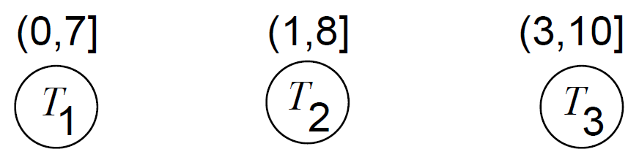
Dependence graph: Timing information
Dependence graphs may contain additional information, for example:
  Timing information
Arrival time
deadline

Slide 16
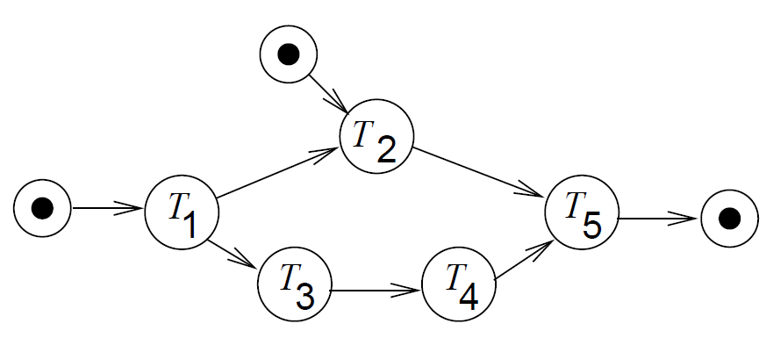
Dependence graph: I/O-information

Slide 17
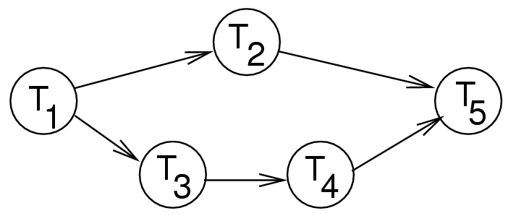
Dependence graph: Shared resources

Slide 18
Dependence graph: Periodic schedules
  A job is single execution of the dependence graph
  Periodic dependence graphs are infinite

Slide 19
Dependence graph: Hierarchical task graphs

Slide 20
Communication
  Shared memory
Comp-1
memory
Comp-2
Variables accessible to several components/tasks.
Model mostly restricted to local systems.

Slide 21
Shared memory
thread a {
u = 1; ..
P(S) //obtain mutex
if u<5 {u = u + 1; ..}
// critical section
V(S) //release mutex
}
thread b {
..
P(S) //obtain mutex
u = 5
// critical section
V(S) //release mutex
}
  Unexpected u=6 possible if P(S) and V(S) is not used
  (double context switch before execution of {u = u+1}
  S: semaphore
  P(S) grants up to n concurrent accesses to resource
  n=1 in this case (mutex/lock)
  V(S) increases number of allowed accesses to resource
  Thread-based (imperative) model should be supported by mutual exclusion for critical sections

Slide 22
On-Site Exercise
thread a {
u = 3; //op a1
P(s);
if u<10 //op a2
{u = u + 1; ..} //op a3
else u=5; //op a4
V(s);
}
thread b {
u = 2; //op b1
P(s);
if u<4 //op b2
{u = u + 4; ..} //op b3
else u=10; //op b4
V(s);
}
Each thread is supposed to be executed once.
Threads can be executed in any sequence and the execution can switch between the two threads at any time.
For the sake of simplicity, we assume that each operation is executed in an atomic manner, i.e. there is no switch (called context switch) during the execution of ax and thread by.
Which values of u are possible at the completion of both tasks?

Slide 23
Non-blocking/asynchronous message passing
Sender does not have to wait until message has arrived;
…
send ()
…
…
receive ()
…
Potential problem: buffer overflow

Slide 24
Blocking/synchronous message passing - rendez-vous
Sender will wait until receiver has received message
…
send ()
…
…
receive ()
…
No buffer overflow, but reduced performance.

Slide 25
Organization of computations within the components (1)
  Finite state machines

Slide 26

Organization of computations within the components (2)
  Discrete event model
queue
5
6
a
b
c
7
5 10 13 15 19
time
action
8
a:=5 b:=7 c:=8 a:=6 a:=9
  Von Neumann model
Sequential execution, program memory etc.

Slide 27

Organization of computations within the components (3)
  Differential equations
  Data flow
  (models the flow of data in a distributed system)
  Petri nets
  (models synchronization in a distributed system)

Slide 28
Summary
Requirements for specification & modeling
  Hierarchy
  ..
  Appropriate model of computation
Models of computation =
    Dependence graphs
    models for communication
    models of components

