Slide 1
SDL
Jian-Jia Chen
(slides are based on Peter Marwedel)
TU Dortmund,
Informatik 12
© Springer, 2010
2014年 10 月 22 日
These slides use Microsoft clip arts. Microsoft copyright restrictions apply.

Slide 2
Models of computation considered in this course
Communication/ local computations | Shared memory | Message passing Synchronous | Asynchronous
Undefined components | Plain text, use cases | (Message) sequence charts
Communicating finite state machines | StateCharts |  | SDL
Data flow |  |  | Kahn networks, SDF
Petri nets |  | C/E nets, P/T nets, …
Discrete event (DE) model | VHDL*, Verilog*, SystemC*, … | Only experimental systems, e.g. distributed DE in Ptolemy
Von Neumann model | C, C++, Java | C, C++, Java with libraries CSP, ADA |
* Based on implementation of VHDL, Verilog..

Slide 3
SDL
  SDL used here as a (prominent) example of a model of computation based on asynchronous message passing communication.
  SDL is appropriate also for distributed systems.
  Just like StateCharts, it is based on the CFSM model of computation; each FSM is called a process.

Slide 4
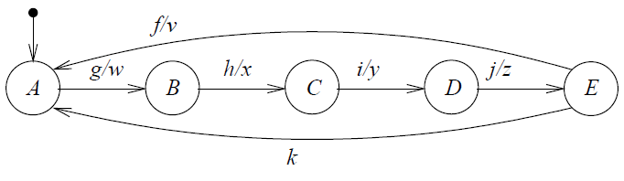
SDL-representation of FSMs/processes
state
input
output

Slide 5
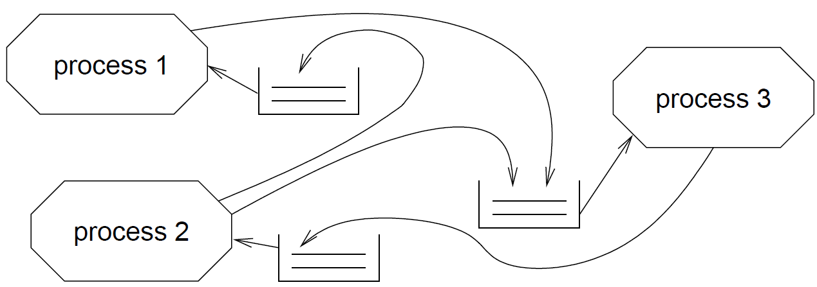
Communication among SDL-FSMs
Communication is based on message-passing of signals (=inputs+outputs), assuming a potentially indefinitely large FIFO-queue.
Each process fetches next signal from FIFO,
checks if signal enables transition,
if yes: transition takes place,
if no: signal is ignored (exception: SAVE-mechanism).
Implementation requires bound for the maximum length of FIFOs

Slide 6
Determinate?
Let signals be arriving at FIFO at the same time:
Order in which they are stored, is unknown:
All orders are legal: simulators can show different behaviors for the same input, all of which are correct.

Slide 7
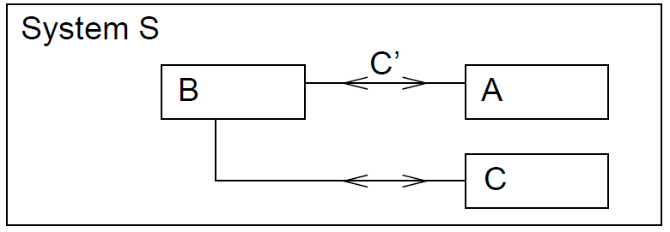
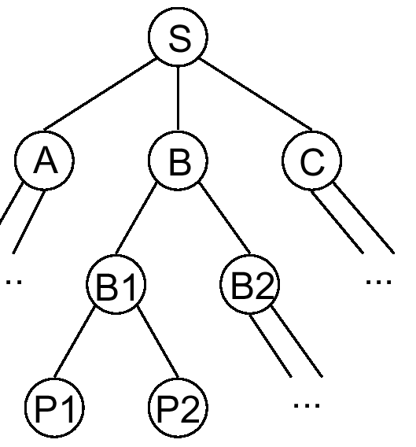
Hierarchy in SDL
Process interaction diagrams can be included in blocks. The root block is called system.
Processes cannot contain other processes, unlike in StateCharts.

Slide 8

Timers
Timers can be declared locally. Elapsed timers put signal into queue. RESET removes timer (also from FIFO-queue).
Not necessarily processed immediately.

Slide 9
Additional language elements
SDL includes a number of additional language elements, like
  procedures
  creation and termination of processes
  advanced description of data
  More features added for SDL-2000

Slide 10
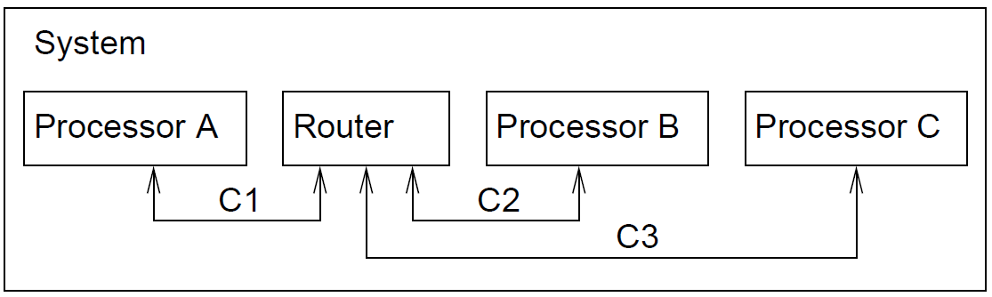
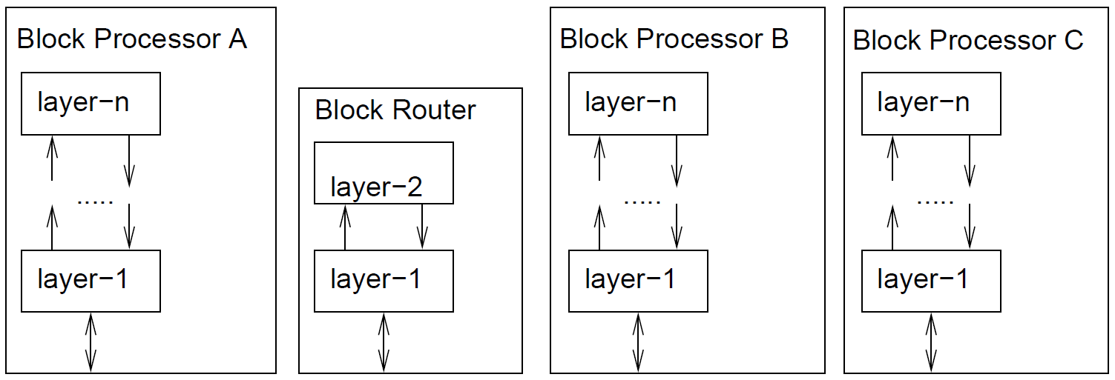
Application: description of network protocols

Slide 11
History
  Dates back to early 1970s,
  Formal semantics defined in the late 1980s,
  Defined by ITU (International Telecommunication Union): Z.100 recommendation in 1980
  Updates in 1984, 1988, 1992, 1996 and 1999
  SDL-2000 a significant update (not well accepted)
  Becoming less popular

Slide 12
Data flow models
Jian-Jia Chen
(Slides are based on
Peter Marwedel)
TU Dortmund,
Informatik 12
© Springer, 2010
2014年 10 月 22 日
These slides use Microsoft clip arts. Microsoft copyright restrictions apply.

Slide 13
Models of computation considered in this course
Communication/ local computations | Shared memory | Message passing Synchronous | Asynchronous
Undefined components | Plain text, use cases | (Message) sequence charts
Communicating finite state machines | StateCharts |  | SDL
Data flow |  |  | Kahn networks, SDF
Petri nets |  | C/E nets, P/T nets, …
Discrete event (DE) model | VHDL, Verilog, SystemC, … | Only experimental systems, e.g. distributed DE in Ptolemy
Von Neumann model | C, C++, Java | C, C++, Java with libraries CSP, ADA |

Slide 14
Data flow as a “natural” model of applications
Example: Video on demand system
www.ece.ubc.ca/~irenek/techpaps/vod/vod.html

Slide 15
Data flow modeling
Definition: Data flow modeling is … “the process
of identifying, modeling and documenting how data moves around an information system.
Data flow modeling examines
  processes (activities that transform data from one form to another),
  data stores (the holding areas for data),
  external entities (what sends data into a system or receives data from a system, and
  data flows (routes by which data can flow)”.
[Wikipedia: Structured systems analysis and design method. http://en.wikipedia.org/wiki/Structured Systems Analysis and Design Methodology, 2010 (formatting added)].

Slide 16
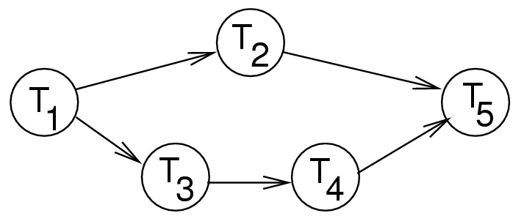
Kahn process networks (KPN)
  Each component is modeled as a program/task/process
  Communication is by FIFOs
  Only one sender and one receiver per FIFO
  ☞ no SDL-like conflicts at FIFOs
  No overflow considered
  ☞ writes never have to wait,
  ☞ reads wait if FIFO is empty.

Slide 17
Example
Process f(in int u, in int v, out int w){
int i; bool b = true;
for (;;) {
i= b ? read(u) : read(v);
//read returns next token in FIFO, waits if empty
send (i,w); //writes a token into a FIFO w/o blocking
b = !b;
}
© R. Gupta (UCSD), W. Wolf (Princeton), 2003
levi animation

Slide 18
Properties of Kahn process networks
  Communication is only via channels
  (no shared variables)
  Mapping from ≥1 input channel
  to ≥1 output channel possible;.

Slide 19
Key Property of Kahn process networks
  Processes have to commit to wait for data from a particular port;
  A process cannot check for available data before attempting a read (wait).
if nonempty(p1) then read(p1)
else if nonempty(p2) then read(p2);
p1
p2
  A process cannot wait for data for >1 port at a time.
read(p1|p2);

Slide 20
Key beauty of KPNs
  Therefore, the order of reads does not depend on the arrival time (but may depend on data).
  Therefore, Kahn process networks are determinate (!); for a given input, the result will be always the same, regardless of the speed of the nodes.
  Many applications in embedded system design:
  Any combination of fast and slow simulation & hardware prototypes always gives the same result.
p1
p2

Slide 21
Computational power and analyzability
  KPNs are Turing-complete
    We can implement a Turing machine as a KPN
    However, the difficulty of Turing machines is also inherited
    Analyzing the maximum FIFO size is “undecidable”
    Analyzing whether it terminates is “undecidable”
    Deadlock may be possible
  Timing is not specified
  Number of processes is static (cannot change)

Slide 22
More information about KPNs
  http://ls12-www.cs.tu-dortmund.de/teaching/download/ levi/index.html: Animation
  See also S. Edwards: http://www.cs.columbia.edu/
  ~sedwards/classes/2001/w4995-02/presentations/dataflow.ppt

Slide 23
SDF
Less computationally powerful, but easier to analyze:
Synchronous data flow (SDF).
  Synchronous
    all the tokens are consumed synchronously
    one way to implement is to have a global clock controlling “firing” of nodes
  Again using asynchronous message passing
  = tasks do not have to wait until output is accepted.

Slide 24
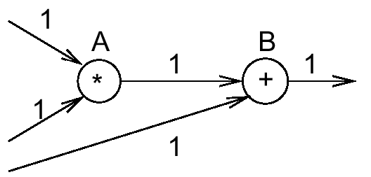

(Homogeneous-)
Synchronous data flow (SDF)
  Nodes are called actors.
  Actors are ready, if the necessary number of input tokens exists and if enough buffer space at the output exists
  Ready actors can fire (be executed).
1
1
  Execution takes a fixed, known time.
Actually, this is a case of homogeneous synchronous data flow models (HSDF): # of tokens per firing the same. 

Slide 25
(Non-homogeneous-)
Synchronous data flow (SDF) (1)
In the general case, a number of tokens can be produced/ consumed per firing
2
3
A ready, can fire (does not have to)

Slide 26
(Non-homogeneous-)
Synchronous data flow (SDF) (2)
In the general case, a number of tokens can be produced/ consumed per firing
2
3
B ready, can fire

Slide 27
(Non-homogeneous-)
Synchronous data flow (SDF) (3)
In the general case, a number of tokens can be produced/ consumed per firing
2
3
A ready, can fire

Slide 28
(Non-homogeneous-)
Synchronous data flow (SDF) (4)
In the general case, a number of tokens can be produced/ consumed per firing
2
3
B ready, can fire

Slide 29
(Non-homogeneous-)
Synchronous data flow (SDF) (5)
In the general case, a number of tokens can be produced/ consumed per firing
2
3
B ready, can fire

Slide 30
(Non-homogeneous-)
Synchronous data flow (SDF) (6)
In the general case, a number of tokens can be produced/ consumed per firing
2
3
A ready, can fire
Replace FIFO by back-edge

Slide 31
Actual modeling of buffer capacity
The capacity of buffers can be modeled easier:
as a backward edge where (initial number of tokens = buffer capacity).
3
2
3
Firing rate depends on # of tokens …

Slide 32
Multi-rate models & balance equations
(one for each channel)
fire A {
…
produce N
…
}
channel
fire B {
…
consume M
…
}
N
FIFO
M
number of tokens consumed
number of tokens produced
number of firings per “iteration”
Determinate
Decidable:
  buffer memory requirements
  deadlock
Schedulable statically
Adopted from: ptolemy.eecs.berkeley.edu/presentations/03/streamingEAL.ppt

Slide 33
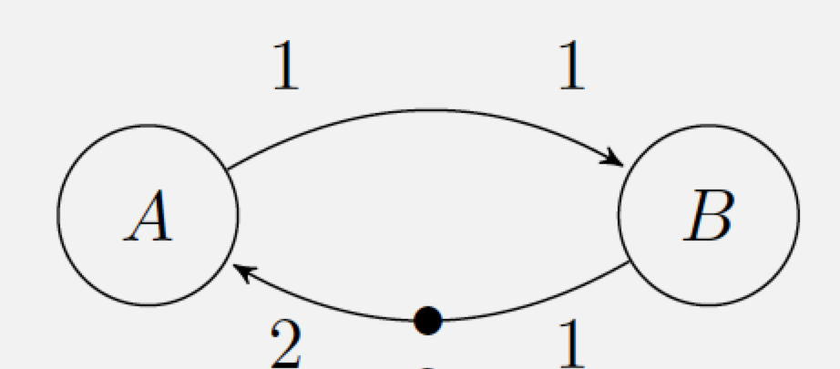
On-site Exercise: Deadlock in SDF
Is it possible to have deadlocks (all the actors are waiting to fire?) in SDF?

Slide 34
Parallel Scheduling of SDF Models
SDF is suitable for automated mapping onto parallel processors and synthesis of parallel circuits.
Many scheduling optimization problems can be formulated.
A
C
B
D
Sequential
Parallel
Source: ptolemy.eecs.berkeley.edu/presentations/03/streamingEAL.ppt

Slide 35
Expressiveness of data flow MoCs
Turing-complete
Not Turing-complete
CSDF=Cyclo static data flow (rates vary in a cyclic way)
[S. Stuijk, 2007]

Slide 36
The expressiveness/analyzability conflict
[S. Stuijk, 2007]

Slide 37
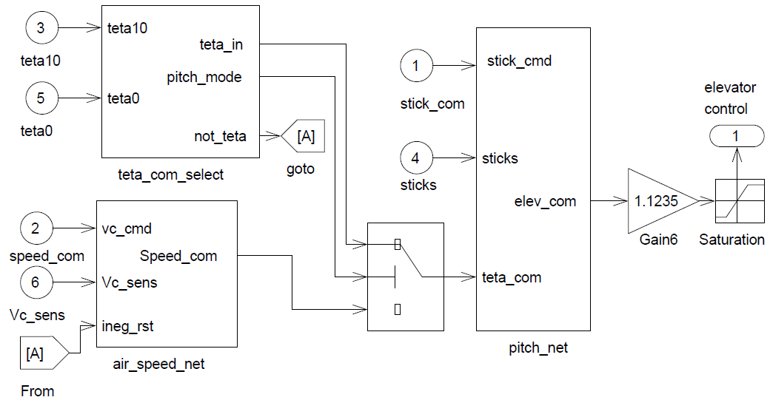
Similar MoC: Simulink
- example -
Semantics? “Simulink uses an idealized timing model for block execution and communication. Both happen infinitely fast at exact points in simulated time. Thereafter, simulated time is advanced by exact time steps. All values on edges are constant in between time steps.” [Nicolae Marian, Yue Ma]
[mathworks]

Slide 39
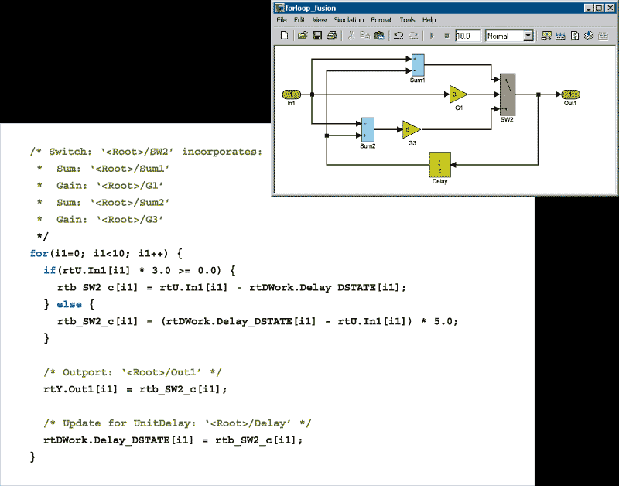
Starting point for
“model-based design”
Code automatically generated
© MathWorks, http://www.mathworks.de/ cmsimages/rt_forloop_code_wl_7430.gif

Slide 41
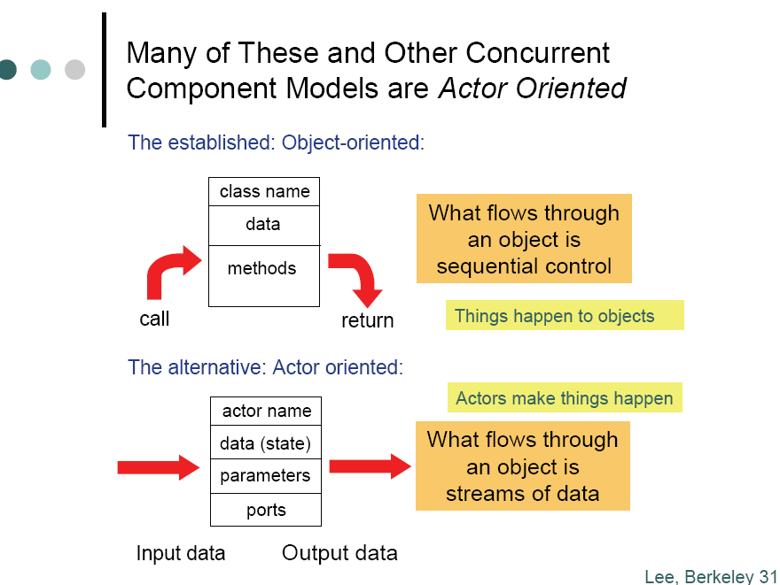
Actor languages
© E. Lee, Berkeley

Slide 42
Summary
  Data flow model of computation
  Motivation, definition
  Kahn process networks (KPNs)
  (H/C)SDF
  Visual programming languages
    Simulink, Real Time Workshop, LabVIEW

