Slide 1
Limits of von-Neumann (thread-based) computing
Jian-Jia Chen
(Slides are based on Peter Marwedel)
TU Dortmund
Informatik 12
© Springer, 2010
2014年 10 月 21 日
These slides use Microsoft clip arts. Microsoft copyright restrictions apply.

Slide 2
Why not use von-Neumann (thread-based) computing (C, C++, Java, …) ?
Potential race conditions (inconsistent results possible)
☞ Critical sections = sections at which exclusive access to resource r (e.g. shared memory) must be guaranteed.
thread a {
..
P(S) //obtain lock
.. // critical section
V(S) //release lock
}
thread b {
..
P(S) //obtain lock
.. // critical section
V(S) //release lock
}
Race-free access to shared memory protected by S possible
This model may be supported by:
  mutual exclusion for critical sections
  special memory properties

Slide 3
Why not just use von-Neumann computing (C, Java, …) (2)?
  Problems with von-Neumann Computing
  Thread-based multiprocessing may access global variables
  We know from the theory of operating systems that
    access to global variables might lead to race conditions,
    to avoid these, we need to use mutual exclusion,
    mutual exclusion may lead to deadlocks,
    avoiding deadlocks is possible only if we accept performance penalties.
  Other problems (need to specify total orders, …)

Slide 4
Consider a Simple Example
“The Observer pattern defines a one-to-many dependency between a subject object and
any number of observer objects
so that when the subject object changes state,
all its observer objects are notified and updated automatically.”
Erich Gamma, Richard Helm, Ralph Johnson, John Vlissides: Design Patterns, Addision-Wesley, 1995
  © Edward Lee, Berkeley, Artemis Conference, Graz, 2007

Slide 5
Example: Observer Pattern in Java
public void addListener(listener) {…}
public void setValue(newvalue) {
myvalue=newvalue;
for (int i=0; i<mylisteners.length; i++) {
myListeners[i].valueChanged(newvalue)
}
}
Would this work in a multithreaded context?
Thanks to Mark S. Miller for the details of this example.
  © Edward Lee, Berkeley, Artemis Conference, Graz, 2007

Slide 6
Example: Observer Pattern with Mutual Exclusion (mutexes)
public synchronized void addListener(listener) {…}
public synchronized void setValue(newvalue) {
myvalue=newvalue;
for (int i=0; i<mylisteners.length; i++) {
myListeners[i].valueChanged(newvalue)
}
}
Javasoft recommends against this.
What’s wrong with it?
  © Edward Lee, Berkeley, Artemis Conference, Graz, 2007

Slide 7
Mutexes using monitors are minefields
public synchronized void addListener(listener) {…}
public synchronized void setValue(newvalue) {
myvalue=newvalue;
for (int i=0; i<mylisteners.length; i++) {
myListeners[i].valueChanged(newvalue)
}
}
x calls addListener
mutex
valueChanged requests
held by x
lock
valueChanged() may attempt to acquire a lock on some other object and stall. If the holder of that lock calls addListener(): deadlock!
  © Edward Lee, Berkeley, Artemis Conference, Graz, 2007

Slide 8
Simple Observer Pattern becomes not so simple
public synchronized void addListener(listener) {…}
public void setValue(newValue) {
synchronized (this) {
myValue=newValue;
listeners=myListeners.clone();
}
for (int i=0; i<listeners.length; i++) {
listeners[i].valueChanged(newValue)
}
}
while holding lock, make a copy of listeners to avoid race conditions
notify each listener outside of the synchronized block to avoid deadlock
This still isn’t right.
What’s wrong with it?
  © Edward Lee, Berkeley, Artemis Conference, Graz, 2007

Slide 9
Simple Observer Pattern: How to Make it Right?
public synchronized void addListener(listener) {…}
public void setValue(newValue) {
synchronized (this) {
myValue=newValue;
listeners=myListeners.clone();
}
for (int i=0; i<listeners.length; i++) {
listeners[i].valueChanged(newValue)
}
}
Suppose two threads call setValue(). One of them will set the value last, leaving that value in the object, but listeners may be notified in the opposite order. The listeners may be alerted to the value-changes in the wrong order!
  © Edward Lee, Berkeley, Artemis Conference, Graz, 2007

Slide 10
Why are deadlocks possible?
We know from the theory of operating systems, that deadlocks are possible in a multi-threaded system if we have
  Mutual exclusion
  Holding resources while waiting for more
  No preemption
  Circular wait
Conditions are met for our example

Slide 11
A stake in the ground …
Nontrivial software written with threads, semaphores, and mutexes is incomprehensible to humans.
“… threads as a concurrency model are a
poor match for embedded systems. … they work well only … where best-effort scheduling policies are sufficient.”
Edward Lee: Absolutely Positively on Time, IEEE Computer, July, 2005
  © Edward Lee, Berkeley, Artemis Conference, Graz, 2007

Slide 12
Ways out of this problem
  Looking for other options (“model-based design”)
  No model that meets all modeling requirements
  ☞ using compromises

Slide 13
Time Automata & Synchronous Languages
Jian-Jia Chen
(Slides are based on Peter Marwedel)
TU Dortmund
Informatik 12
© Springer, 2010
2014年 10 月 21 日
These slides use Microsoft clip arts. Microsoft copyright restrictions apply.

Slide 14
Models of computation
Communication/ local computations | Shared memory | Message passing Synchronous | Asynchronous
Undefined components | Plain text, use cases | (Message) sequence charts
Communicating finite state machines | StateCharts |  | SDL
Data flow | Scoreboarding + Tomasulo Algorithm ( Comp. Archict.) |  | Kahn networks, SDF
Petri nets |  | C/E nets, P/T nets, …
Discrete event (DE) model | VHDL, Verilog, SystemC, … | Only experimental systems, e.g. distributed DE in Ptolemy
Von Neumann model | C, C++, Java | C, C++, Java with libraries CSP, ADA |

Slide 15
StateCharts: recap of classical automata
Classical automata:
input X
Internal state Z
output Y
clock
Moore- + Mealy automata=finite state machines (FSMs)
Next state Z⁺ computed by function δ
Output computed by function λ
Z0
e=1
Z1
Moore-automata:
Y = λ (Z); Z⁺ = δ (X, Z)
Mealy-automata
Y = λ (X, Z); Z⁺ = δ (X, Z)
0
1
e=1
e=1
Z3
Z2
3
e=1
2

Slide 16
Timed automata
  Timed automata = automata + models of time
  The variables model the logical clocks in the system, that are initialized with zero when the system is started, and then increase synchronously with the same rate.
  Clock constraints i.e. guards on edges are used to restrict the behavior of the automaton.
  A transition represented by an edge can be taken when the clocks values satisfy the guard labeled on the edge.
  Additional invariants make sure, the transition is taken.
  Clocks may be reset to zero when a transition is taken
  [Bengtsson and Yi, 2004].

Slide 17
Example: Answering machine
Ensures that transition takes place
May take place, but does not have to

Slide 18
Definitions
Let C: real-valued variables C representing clocks.
Let Σ: finite alphabet of possible inputs.
Definition: A clock constraint is a conjunctive formula of atomic constraints of the form
x ◦ n or x−y ◦ n for x, y ∈ C, ◦ ∈ {≤,<,=,>,≥} and n ∈N
Let B(C) be the set of clock constraints.
Definition: A timed automaton A is a tuple (S, s₀,E, I) where
S is a finite set of states, s₀ is the initial state,
E ⊆ S×B(C)× Σ ×2^{C} ×S is the set of edges,
B(C): conjunctive condition, 2^{C}: variables to be reset
I : S→B(C) is the set of invariants for each of the states
B(C): invariant that must hold for state S

Slide 19
Definitions (2)
Let C: real-valued variables C representing clocks.
Let Σ: finite alphabet of possible inputs.
Definition: A clock constraint is a conjunctive formula of atomic constraints of the form x ◦ n or x−y ◦ n for x, y ∈ C, ◦ ∈ {≤,<,=,>,≥} and n ∈N
Let B(C) be the set of clock constraints.
Definition: A timed automaton A is a tuple (S, s₀,E, I) where S is a finite set of states, s₀ is the initial state,
E ⊆ S×B(C)× Σ ×2^{C} ×S is the set of edges, B(C): conjunctive condition, 2^{C}: variables to be reset
I : S→B(C) is the set of invariants for each of the states, B(C): invariant that must hold for state S

Slide 20
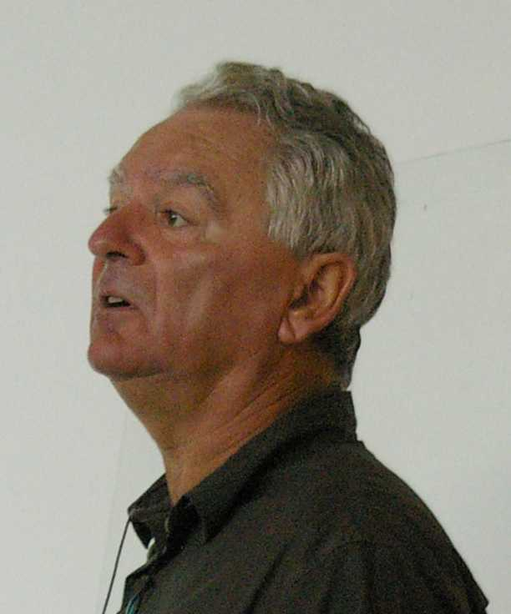
Synchronous vs. asynchronous languages (1)
Description of several processes in many languages non-determinate: The order in which executable threads are executed is not specified (may affect result).
Synchronous languages: based on automata models.
“Synchronous languages aim at providing high
level, modular constructs, to make the design
of such an automaton easier [Nicolas Halbwachs].
Synchronous languages describe concurrently
operating automata. “.. when automata are
composed in parallel, a transition of the product
is made of the "simultaneous" transitions of all of them“.
© P. Marwedel, 2008

Slide 21

Synchronous vs. asynchronous languages (2)
Synchronous languages implicitly assume the presence of a (global) clock.
Each clock tick, all inputs are considered, new outputs and states are calculated and then the transitions are made.

Slide 22
Abstraction of delays
Let
  f(x): some function computed from input x,
  Δ(f(x)): the delay for this computation
  δ: some abstraction of the real delay
Consider compositionality: f(x)=g(h(x))
Then, the sum of the delays of g and h would be a safe upper bound on the delay of f.
Two solutions:
  δ =0, always  synchrony
  δ =? (hopefully bounded)  asynchrony
Asynchronous languages don’t work [Halbwachs]
(Examples based on missing link to real time, e.g. what exactly does a wait(10 ns) in a programming language do?)
Based on slide 15 of N. Halbwachs: Synchronous Programming of Reactive Systems, ARTIST2 Summer School on Embedded Systems, Florianopolis, 2008

Slide 23
Compositionality
At the abstract level, a single FSM reacts immediately
At the abstract level, reaction of connected other automata is immediate
Based on slide 16 of N. Halbwachs: Synchronous Programming of Reactive Systems, ARTIST2 Summer School on Embedded Systems, Florianopolis, 2008

Slide 24
Concrete Behavior
The abstraction of synchronous languages is valid, as long as real delays are always shorter than the clock period.
Reference: slide 17 of N. Halbwachs: Synchronous Programming of Reactive Systems, ARTIST2 Summer School on Embedded Systems, Florianopolis, 2008

Slide 25
Synchronous languages
  Require a broadcast mechanism for all parts of the model.
  Idealistic view of concurrency.
  Have the advantage of guaranteeing determinate behavior.
  ☞ StateCharts (using StateMate semantics)
  is an “almost” synchronous language [Halbwachs].
  Immediate communication is the lacking feature which would make StateCharts a fully synchronous language.

Slide 26
Implementation and specification model
For synchronous languages, the implementation model is that of finite state machines (FSMs).
The specification may use different notational styles
  “Imperative”: Esterel (textual)
  SyncCharts: graphical version of Esterel
  “Data-flow”: Lustre (textual)
  SCADE (graphical) is a mix containing elements from multiple styles
Nevertheless, specifications always include a close link to the generated FSMs (i.e., “imperative” does not have semantics close to von-Neumann languages)

Slide 27

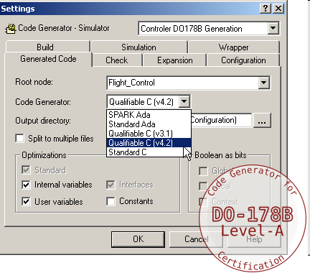

Applications
SCADE Suite, including the SCADE KCG
Qualified Code Generator, is used by AIRBUS and many of its main suppliers for the development of most of the A380 and A400M critical on board software, and for the A340-500/600 Secondary Flying Command System, aircraft in operational use since August 2002.
François Pilarski, Systems Engineering Framework - Senior Manager Engineering,Systems & Integration Tests; Airbus France.
Instance of “model-based design”
Acquired by ANSYS in May 2012
Source: http://www.esterel-technologies.com/products/scade-suite/

Slide 29
Summary
  Mutual Exclusion (Resource Sharing)
  Timed Automata
  Synchronous languages
    Based on clocked finite state machine view
    Based on 0-delay (real delays must be small)

